Slide 1

React Flow
Presented By: Md Zakaria Masud (Software Engineer)

Slide 2
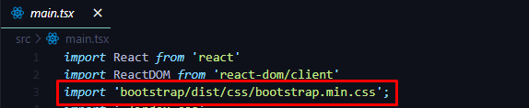
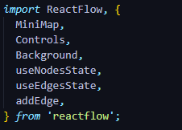
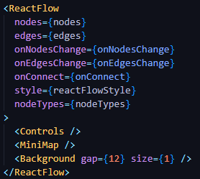
Installing react flow into the react project
$ npm install reactflow
Installing react-bootstrap for styling nodes
$ npm install react-bootstrap bootstrap
Showing react flow into a react component
Setup React Flow

Slide 3
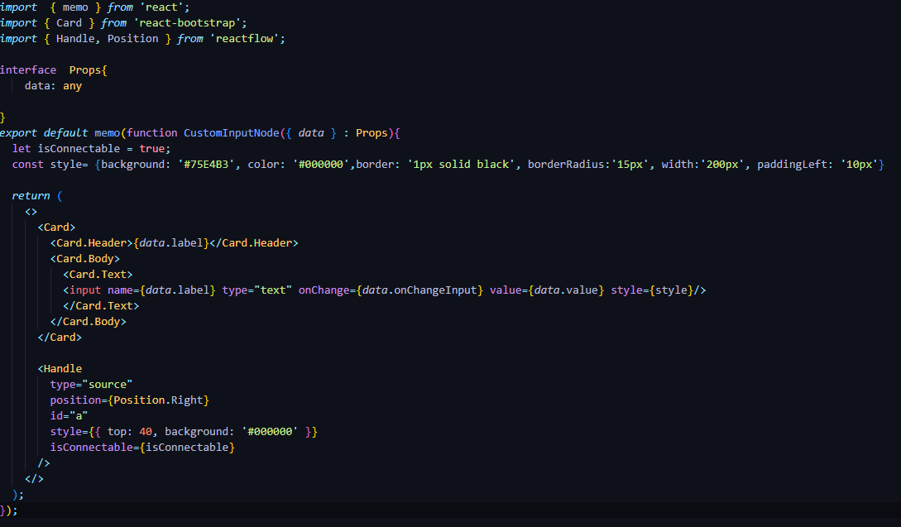
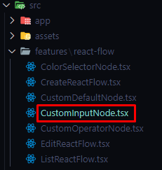
Input Node
Creating Custom Node with React Component : Input Node

Slide 4
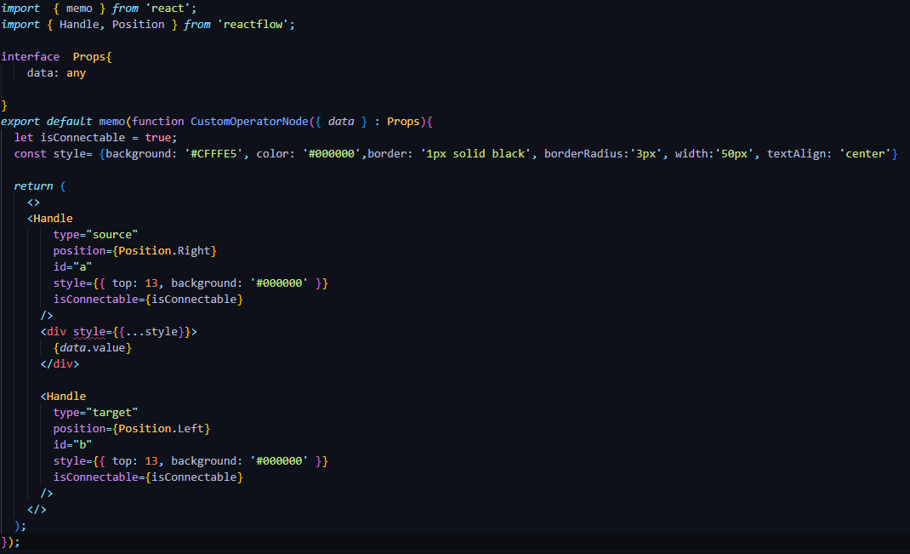
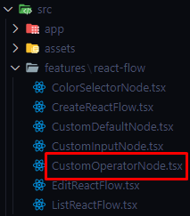
Operator Node
Creating Custom Node with React Component : Operator Node

Slide 5
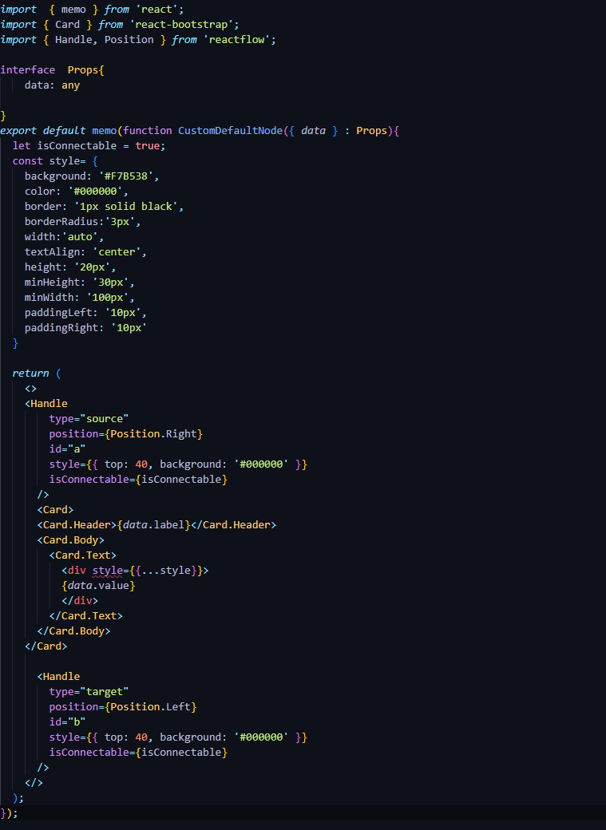
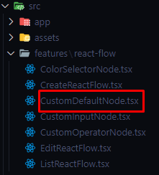
Default / Computed Node
Creating Custom Node with React Component : Operator Node

Slide 6
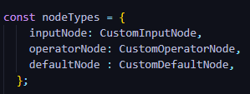
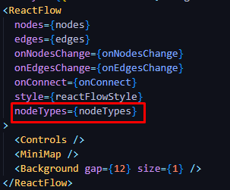
Declare Node Type
Using custom node with react flow
Using Custom Node with React flow

Slide 7
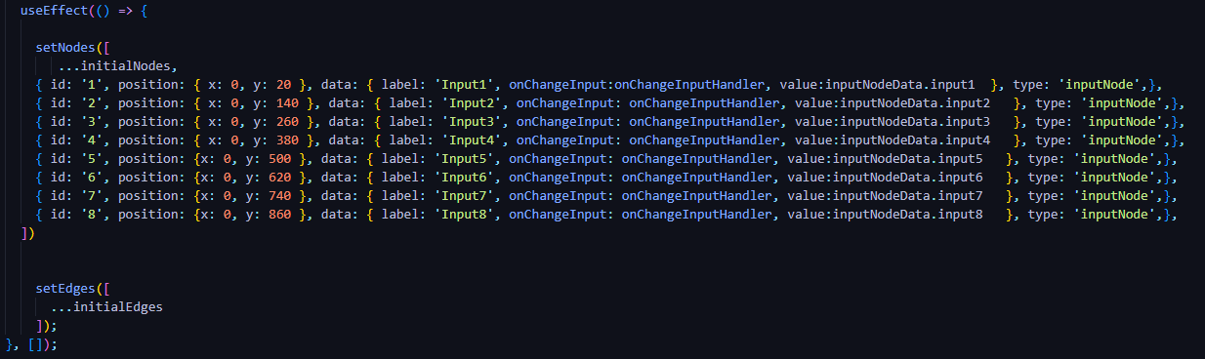
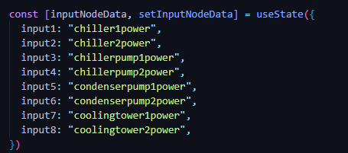
State for Nodes and Edges
Seed some input nodes and states of them
React flow Functionalities

Slide 8
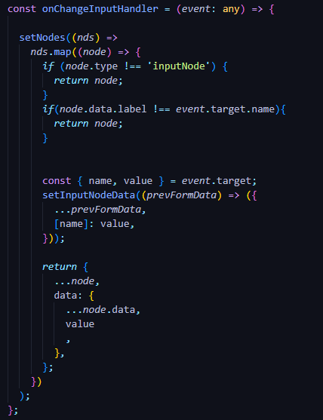
Input Nodes onChangeInputHandler
React flow Functionalities

Slide 9
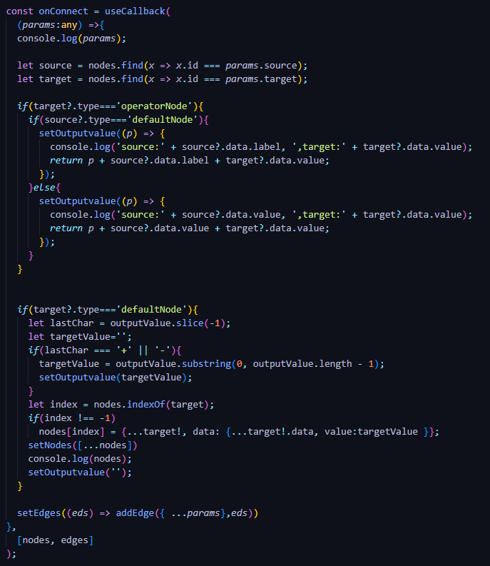
Nodes onConnect hadler for connecting edges and controlling state of nodes
React flow Functionalities

Slide 10
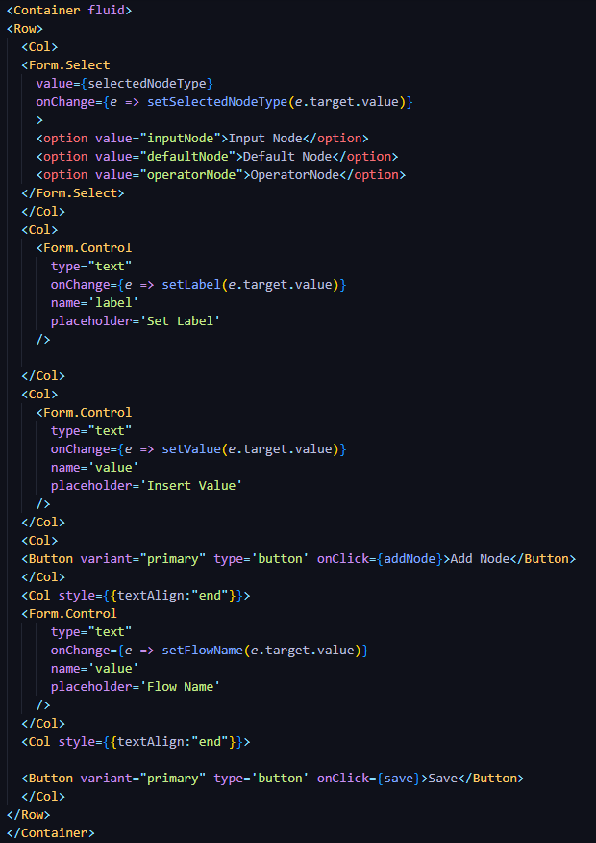

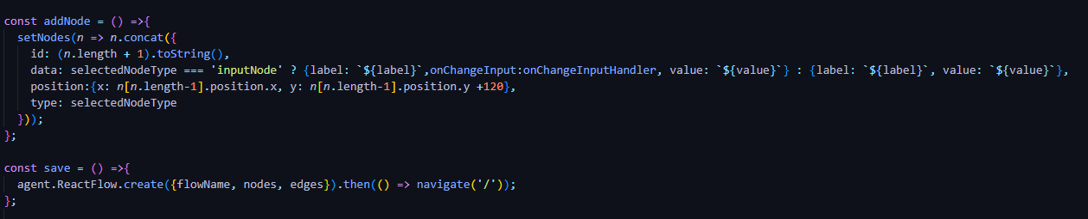
Control UI and functionality for adding nodes setting values, setting labels and saving flows
React flow Functionalities

Slide 11
Thank You

